Slide 1
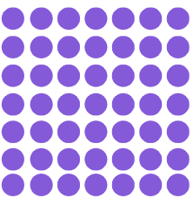
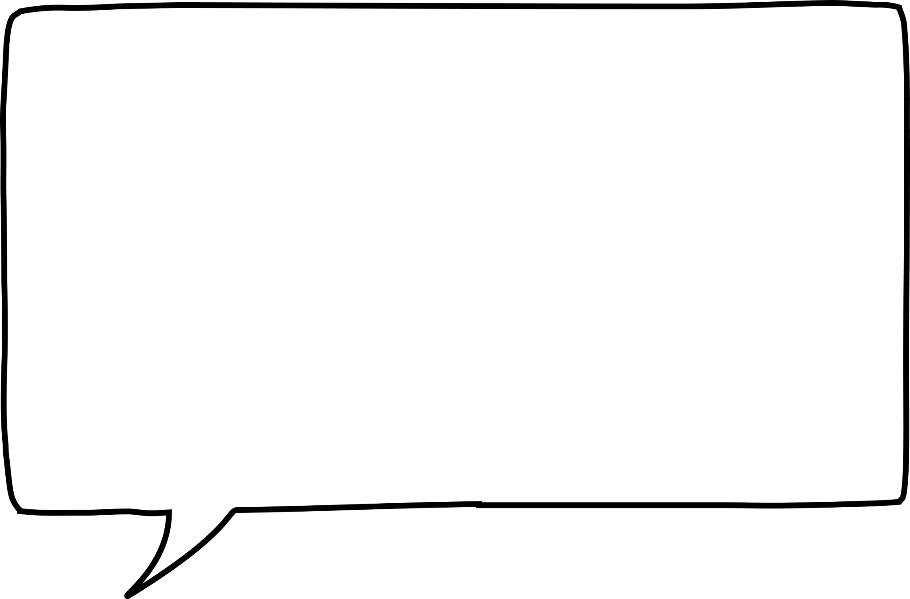


Square and cube numbers
Task A: Square numbers
Match up the arrays with the correct square number.
64
16
25
49
2) Work out the age given the clues.
1
4
9
16
25
36
49
64
My teacher’s age is:
a square number,
a multiple of 3,
and less than 70.
Alex is a student at Oak Academy.
Alex’s age is:
4 less than a square number and is an even number.
How old is the teacher?
How old is Alex?
Teacher’s age is 36
Alex’s age is 12
3) Identify if the following statements are true or false. Justify your answer.
Statement | True | False | Justification
121 is a square number
13 ✕ 13 = 169 so 13 is a square number
4 add 3 then multiply by 7 gives a square number
7 multiplied by 4 then add 3 gives a square number
11 ✕ 11 = 121
169 is the square number
4+3 = 7 then 7 ✕ 7 = 49
49 is a square number
7 ✕ 4 =28 then 28 + 3 = 31
31 is not a square number

Slide 2
Square and cube numbers
4) Jun discovers he can sum two different square numbers to make a third square number.
Can you find the missing square numbers to complete this table?
1st square number | 2nd square number | Resultant square number
9 | 16 | 25
36 | 64 | 100
25 | 144 | 169
Can you find another set of two different square numbers to make a third square number?
There are many out there. E.g. 81+144=225 and 64+225=289
5) How many squares can you see on an 8 by 8 chess board?
204 squares.
This is because you have to calculate how many 1 x 1 squares, 2 x 2 square, 3 x 3 squares and so on.
These numbers end up being the square numbers: 64, 49, 36, 25, 16, 9, 4, 1. Summing these gives 204 squares on a chessboard,
Task B: Cube numbers
Identify all the cube numbers from the list below.
1 2 3 4 8 9 10
16 25 27 36 40 49
64 100 121 125 169
1000
2) Put the following numbers in the Venn diagram:
1 3 4 8 9
16 25 27 36 40 49
64 125 216 1000
Square numbers
Cube
numbers
36
1
4
125
49
1000
9
64
27
25
216
3
16
8
40
Mathematics in Education and Industry

Slide 3
Square and cube numbers
3) Fill in the number to make the calculation correct.
The number in the SQUARE is a square number
The number in the CUBE is a cube number.
⬜ + 🧊 = 31
⬜ + 🧊 = 33
⬜ + 🧊 = 225
⬜ + ⬜ + 🧊 = 104
🧊 + 🧊 + 🧊 = 36
4 + 27 = 31
25 + 8 = 33
100 + 125 = 225
36 + 4 + 64 = 104
1 + 8 +27 = 36
Mathematics in Education and Industry

